Slide 1
Intermediate Code Generation

Slide 2
Direct Acyclic Graph
Like the syntax tree for an expression, a DAG has leaves corresponding to atomic operands and interior nodes corresponding to operators.
The difference is that a node N in a DAG has more than one parent. if N represents a common sub expression;
In a syntax tree, the tree for the common sub expression would be replicated as many times as the sub expression appears in the original expression. Thus, a DAG not only represents expressions more succinctly, it gives the compiler important clues regarding the generation of efficient code to evaluate the expressions

Slide 3
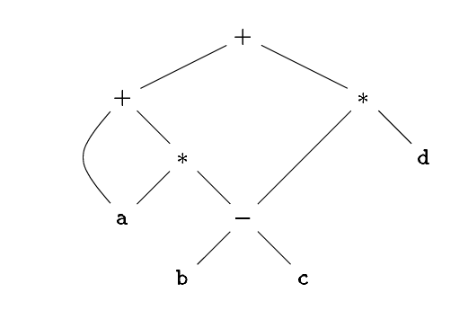
Show the DAG for the expression a + a * (b- c) + (b- c) * d .
The leaf for a has two parents, because a appears twice in the expression.
The two occurrences of the common subexpression b-c are represented by one node, the node labeled .
That node has two parents, representing its two uses in the subexpressions a*(b-c) and (b-c)*d.
Even though b and c appear twice in the complete expression, their nodes each have one parent, since both uses are in the common subexpression b-c.

Slide 4
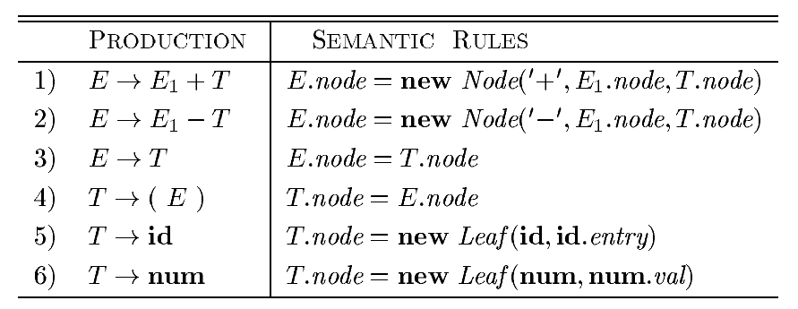
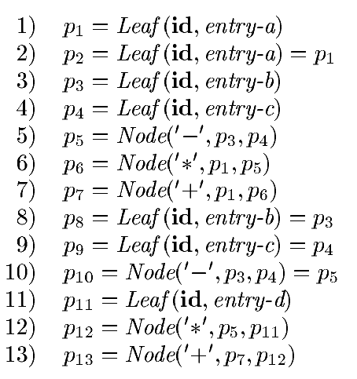
Syntax-directed definition to produce syntax trees or DAG's
It will construct a DAG if, before creating a new node, these functions first check whether an identical node already exists. If a previously created identical node exists, the existing node is returned. For instance, before constructing a new node, Node(op;left;right), we check whether there is already a node with label op, and children left and right, in that order. If so, Node returns the existing node; otherwise, it creates a new node.

Slide 5
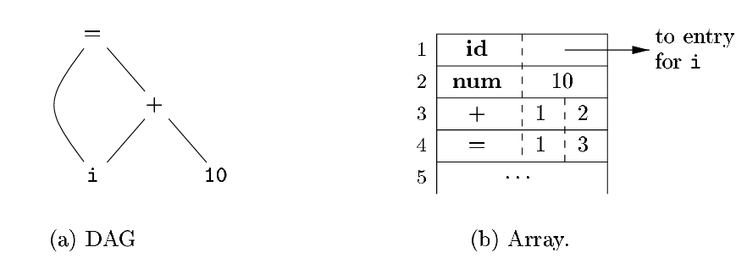
The Value Number Method for Constructing DAG
The nodes of a syntax tree or DAG are stored in an array of records.
Each row of the array represents one record, and therefore one node.
In each record, the first field is an operation code, indicating the label of the node.
Leaves have one additional field, which holds the lexical value (either a symbol-table pointer or a constant, in this case),
and interior nodes have two additional fields indicating the left and right children.

Slide 6
Algorithm : The value-number method for constructing the nodes of a DAG.
INPUT: Label op, node l, and node r.
OUTPUT: The value number of a node in the array with signature (op, l, r).
METHOD:
Search the array for a node M with label op, left child l, and right child r.
If there is such a node, return the value number of M.
If not, create in the array a new node N with label op, left child l, and right child r, and return its value number.

Slide 7
Construct the DAG for the expression ((x +y) -((x+y) *(x-y)))+((x+y) *(x-y))

Slide 8
List of the common three-address instruction forms:
Assignment instructions of the form x = y op z, where op is a binary arithmetic or logical operation, and x, y, and z are addresses.
Assignments of the form x = op y, where op is a unary operation. Essential unary operations include unary minus, logical negation, and conversion operators that, for example, convert an integer to a floating-point number.
Copy instructions of the form x = y, where x is assigned the value of y.
An unconditional jump goto L. The three-address instruction with label L is the next to be executed.
Conditional jumps of the form if x goto L and if False x goto L. These instructions execute the instruction with label L next if x is true and false, respectively. Otherwise, the following three-address instruction in sequence is executed next, as usual.
Conditional jumps such as if x relop y goto L, which apply a relational operator (=, etc.) to x and y, and execute the instruction with label L next if x stands in relation relop to y. If not, the three-address instruction following if x relop y goto L is executed next, in sequence.

Slide 9
List of the common three-address instruction forms:
7. Procedure calls and returns are implemented using the following instructions: param x for parameters; call p,n and y = call p,n for procedure and function calls, respectively; and return y, where y, representing a returned value, is optional. Their typical use is as the sequence of three address instructions
param x1
param x2
……..
param xn
call p,n generated as part of a call of the procedure p(x1,x2,….,xn).
The integer n, indicating the number of actual parameters in “call p,n” is not redundant because calls can be nested. That is, some of the first param statements could be parameters of a call that comes after p returns its value; that value becomes another parameter of the later call.

Slide 10
List of the common three-address instruction forms:
8. Indexed copy instructions of the form x=y[i] and x[i]=y. The instruction x=y[i] sets x to the value in the location i memory units beyond location y. The instruction x[i]=y sets the contents of the location i units beyond x to the value of y.
9. Address and pointer assignments of the form x =&y, x =*y, and *x = y. The instruction x =&y sets the r-value of x to be the location (l-value) of y.2 Presumably y is a name, perhaps a temporary, that denotes an expression with an l-value such as A[i][j], and x is a pointer name or temporary. In the instruction x = *y, presumably y is a pointer or a temporary whose r-value is a location. The r-value of x is made equal to the contents of that location. Finally, *x = y sets the r-value of the object pointed to by x to the r-value of y.

Slide 11
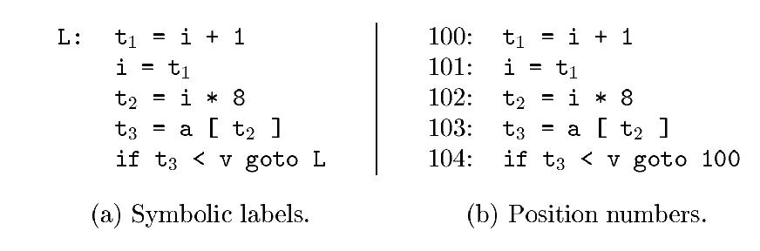
Consider the statement do i = i+1; while (a[i] < v);

Slide 12
Quadruple
A quadruple (or just “quad") has four fields, which we call op, arg1, arg2, and result.
The op field contains an internal code for the operator. For instance, the three-address instruction x = y+z is represented by placing + in op, y in arg1, z in arg2, and x in result.
The following are some exceptions to this rule:
1. Instructions with unary operators like x = minus y or x = y do not use arg2. Note that for a copy statement like x = y, op is =, while for most other operations, the assignment operator is implied.
2. Operators like param use neither arg2 nor result.
3. Conditional and unconditional jumps put the target label in result.

Slide 13
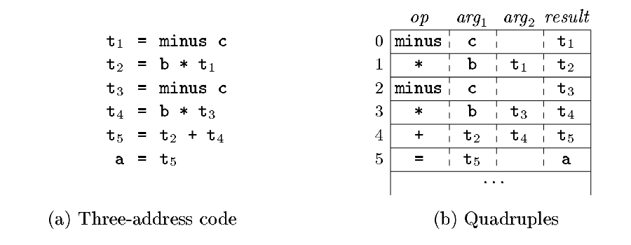
Three-address code for the assignment a = b*-c+b*-c;

Slide 14
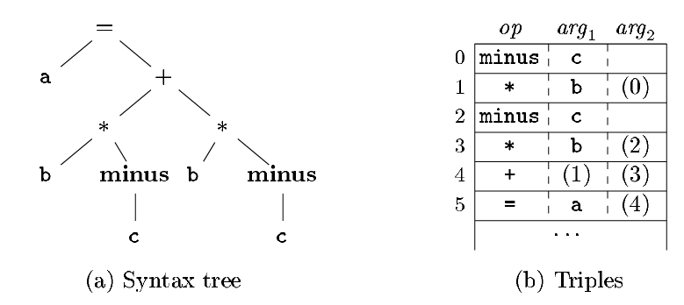
Triples
A triple has only three fields, which we call op, arg1, and arg2.
Using triples, we refer to the result of an operation x op y by its position, rather than by an explicit temporary name.
Thus, instead of the temporary t1, a triple representation would refer to position (0). Parenthesized numbers represent pointers into the triple structure itself.

Slide 15
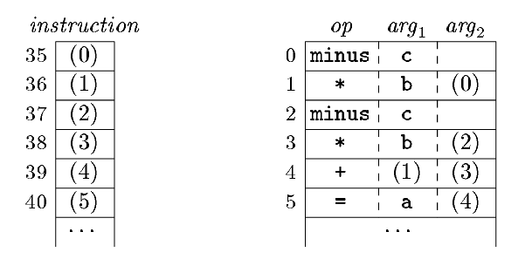
Indirect Triple
Indirect triples consist of a listing of pointers to triples, rather than a listing of triples themselves.
For example, let us use an array instruction to list pointers to triples in the desired order.

Slide 16
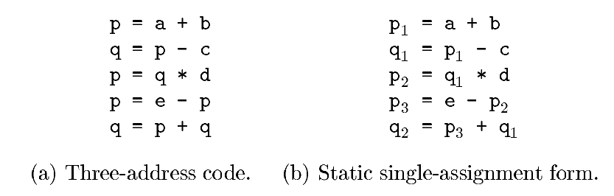
Static Single Assignment Form
Static single-assignment form (SSA) is an intermediate representation that facilitates certain code optimizations.
Two distinctive aspects distinguish SSA from three-address code.
The first is that all assignments in SSA are to variables with distinct names; hence the term static single-assignment

Slide 17
The same variable may be defined in two different control flow paths in a program.
Here is where the second distinctive aspect of SSA comes into play. SSA uses a notational convention called the-function to combine the two definitions of x: if ( flag ) x1 =-1; else x2 = 1; x3 = Φ (x1;x2)
Here, Φ(x1;x2) has the value x1 if the control flow passes through the true part of the conditional and the value x2 if the control flow passes through the false part. That is to say, the-function returns the value of its argument that corresponds to the control- flow path that was taken to get to the assignment statement containing the-function
For example, the source program if ( flag ) x =-1; else x = 1; y = x * a; has two control flow paths in which the variable x gets defined. If we use different names for x in the true part and the false part of the conditional statement, then which name should we use in the assignment y = x * a?

Slide 18
Types and Declarations -
Applications of Types
Type checking uses logical rules to reason about the behavior of a program at run time. Specifically, it ensures that the types of the operands match the type expected by an operator.
Translation Applications. From the type of a name, a compiler can determine the storage that will be needed for that name at run time. Type information is also needed to calculate the address denoted by an array reference, to insert explicit type conversions, and to choose the right version of an arithmetic operator, among other things.

Slide 19
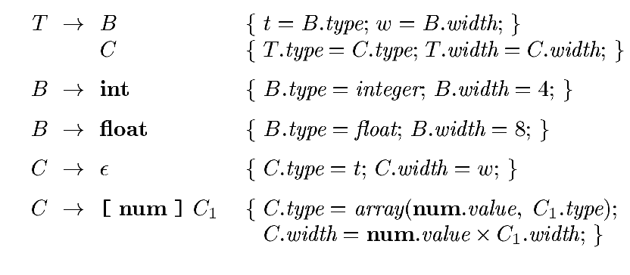
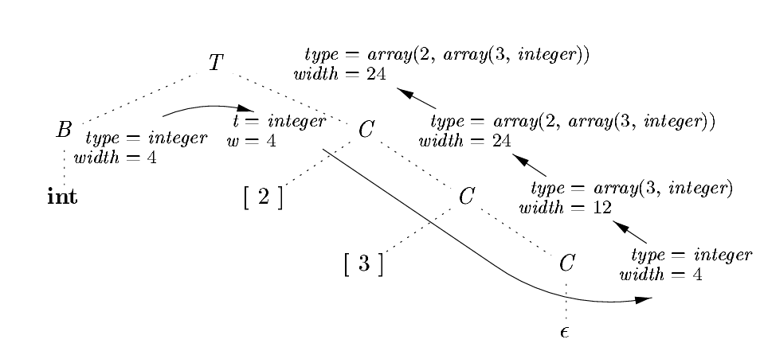
Computing types and their widths

Slide 20
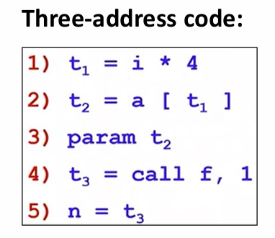
Procedures
In three-address code, a function call is unraveled into the evaluation of parameters in preparation for a call, followed by the call itself.
Suppose that a is an array of integers, and that f is a function from integers to integers.
Then, the assignment n = f ( a [ i ] ) ;
Three-address code:
f is a function and ( a [ i ] ) is the parameter of the function.
The first two lines compute the value of the expression a [ i ] into temporary t2.
Line 3 makes t2 an actual parameter for the call on line 4 of f with one parameter.
Line 5 assigns the value returned by the function call to t3 .

Slide 21
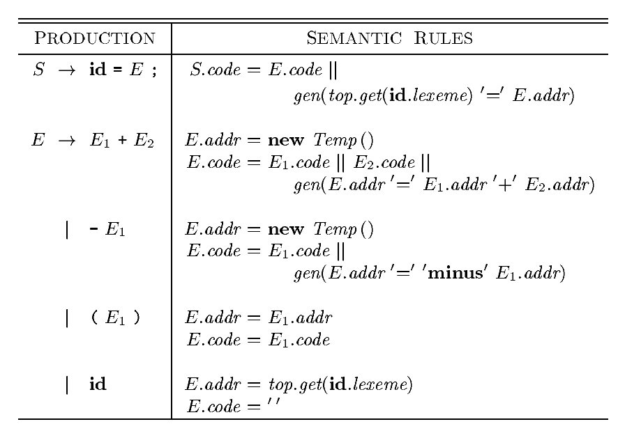
Translation of Expressions-(Assignment Statements)-
Attributes S.code and E.code denote the three-address code for S and E, respectively.
Attribute E.addr denotes the address that will hold the value of E.
For the production E→id , the semantic rules for this production define E.addr to point to the symbol-table entry for this instance of id.
Finally, the production S→id=E; generates instructions that assign the value of expression E to the identifier id. The semantic rule for this production uses function top.get to determine the address of the identifier represented by id, as in the rules for E→id.
S.code consists of the instructions to compute the value of E into an address given by E.addr, followed by an assignment to the address top.get(id.lexeme) for this instance of id.
Three-address code for Assignment Statement

Slide 22
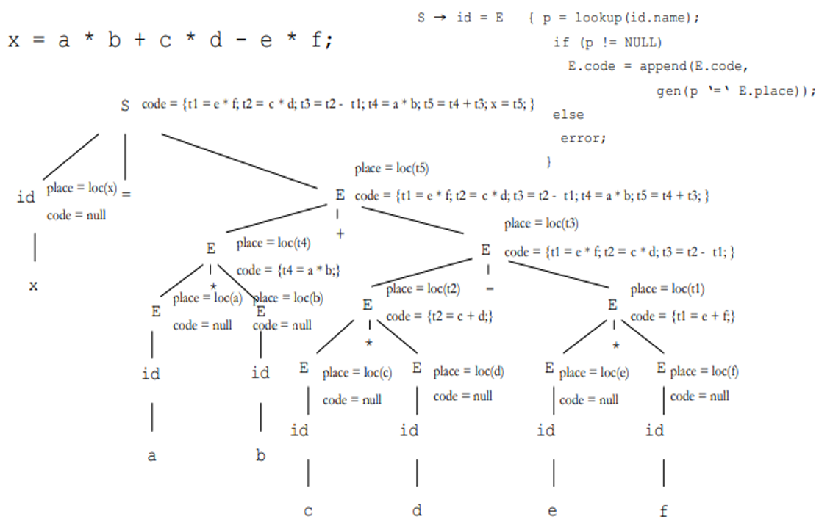

Slide 23
Control Flow
Boolean Expressions are often used to :
Alter the flow of control.
Boolean expressions are used as conditional expressions in statements that alter the flow of control.
The value of such boolean expressions is implicit in a position reached in a program.
For example, in if (E) S, the expression E must be true if statement S is reached.
Compute logical values.
A boolean expression can represent true or false as values.
Such boolean expressions can be evaluated in analogy to arithmetic expressions using three-address instructions with logical operators.

Slide 24
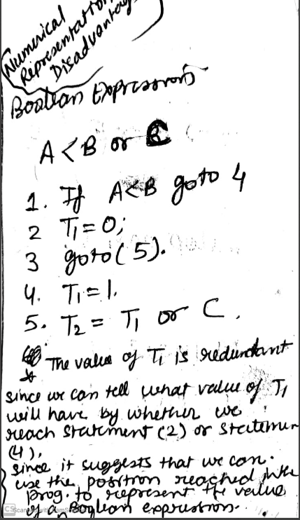
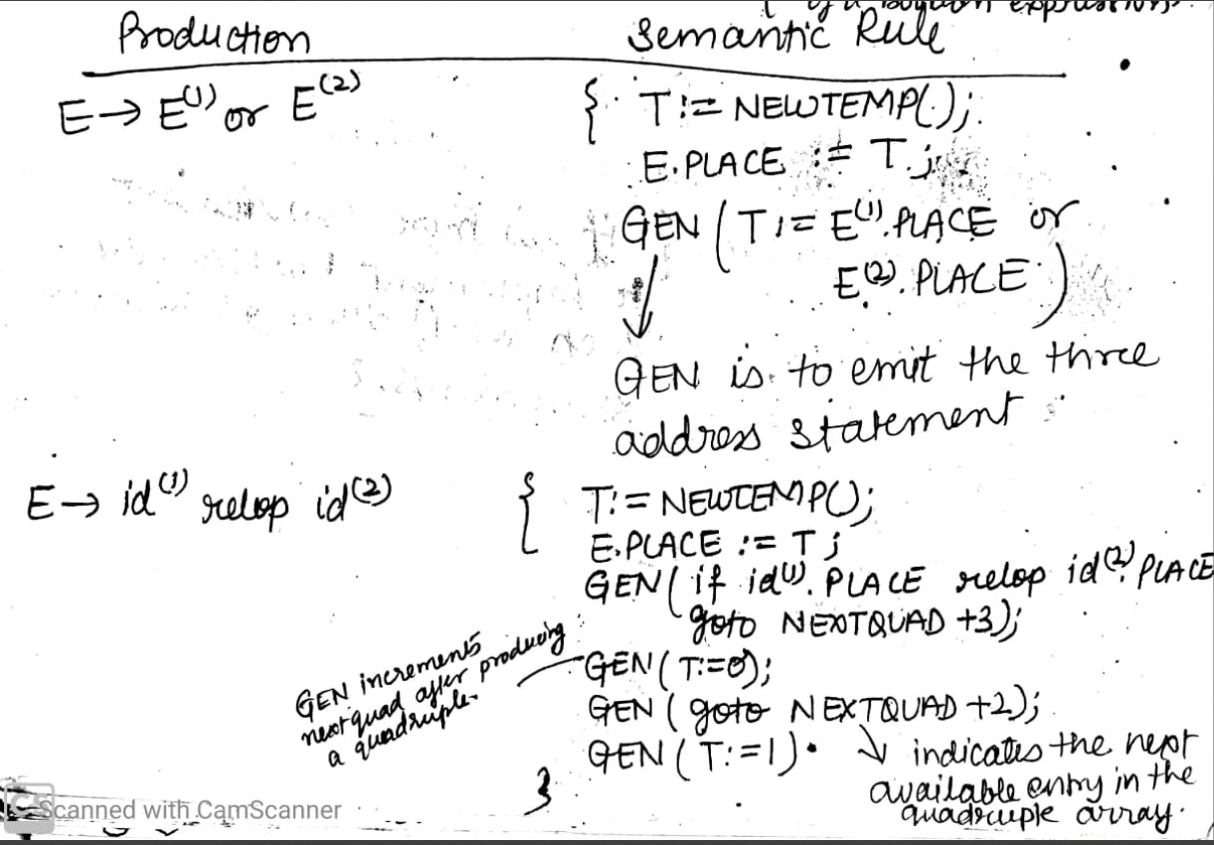
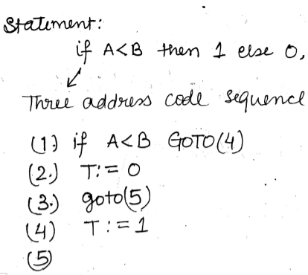
Boolean Expression
B → B||B | B&&B | !B | (B) | E rel E | true | false
Numerical Representation

Slide 25
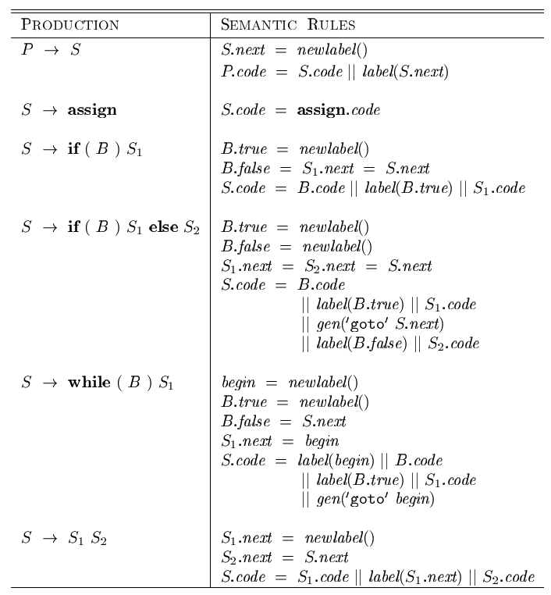
Control Flow Statements
if( x < 100 || x > 200 && x != y ) x = 0;
Using the syntax-directed definitions
if x < 100 goto L2
goto L3
L3: if x > 200 goto L4
goto L1
L4: if x != y goto L2
goto L1
L2: x = 0
L1:

Slide 26
Back Patching.
A key problem when generating code for boolean expressions and flow-of-control statements is that of matching a jump instruction with the target of the jump.
For example, the translation of the boolean expression B in if (B ) S contains a jump, for when B is false, to the instruction following the code for S.
In a one-pass translation, B must be translated before S is examined. What then is the target of the goto that jumps over the code for S?
To manipulate lists of jumps, we use three functions:
1. makelist(i) : creates a new list containing only i, an index into the array of instructions; makelist returns a pointer to the newly created list.
2. merge(p1,p2) concatenates the lists pointed to by p1 and p2, and returns a pointer to the concatenated list.
3. backpatch(p,i) inserts i as the target label for each of the instructions on the list pointed to by p

Slide 27
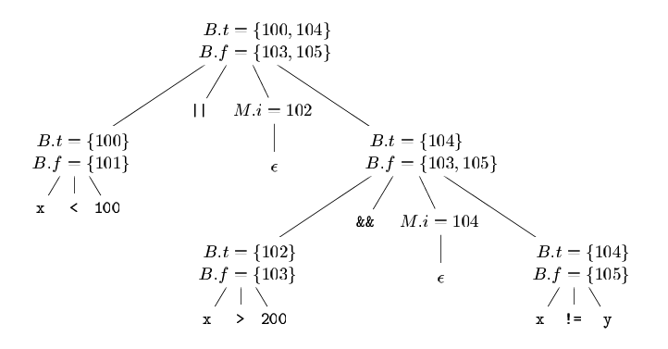
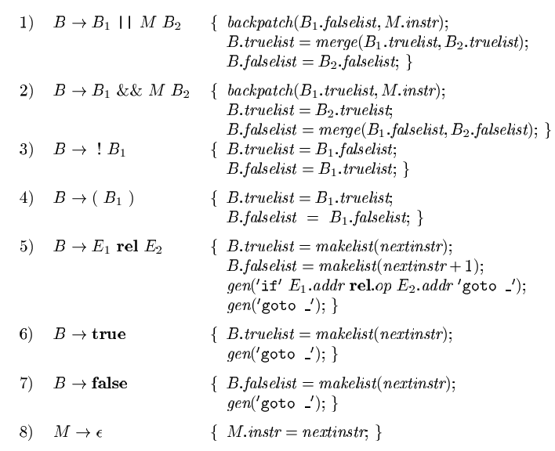
Backpatching
Annotated parse tree for x<100 || x>200 && x != y

Slide 29
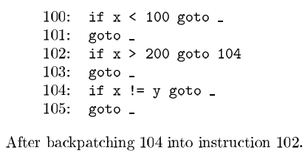
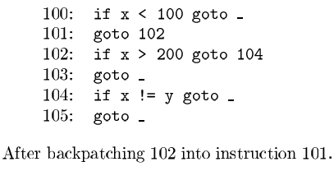
100: if x < 100 goto
101: goto
102: if x > 200 goto
103: goto
104: if x != y goto
105: goto
x < 100|| x > 200 && x != y
100: if x < 100 goto 106
101: goto 102
102: if x > 200 goto 104
103: goto 107
104: if x != y goto 106
105: goto 107
106:True
107: False

Slide 30
Switch Case Statements
switch (ch)
{
case 1 : c = a + b;
break;
case 2 : c = a – b;
break;
}
Three address code for the given code is-
if ch = 1 goto L1
if ch = 2 goto L2
L1:
T1 = a + b
c = T1
goto Last
L2:
T1 = a – b
c = T2
goto Last
Last:

Slide 31
THANK YOU

